Slide 1
Visible Light based Activity Sensing using Ceiling Photosensors
Mohamed Ibrahim, Viet Nguyen, Siddharth Rupavatharam, Minitha Jawahar, Marco Gruteser, Richard Howard
WINLAB, Rutgers University

Slide 2
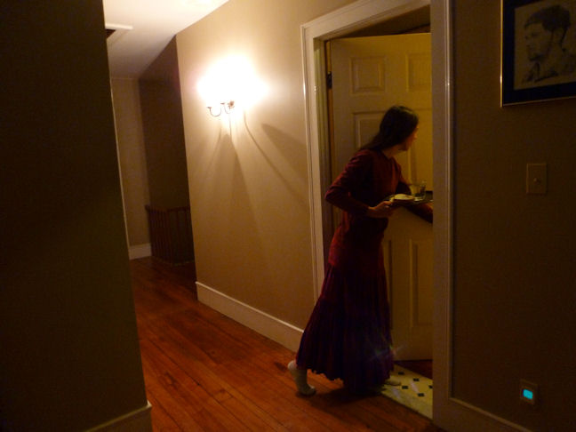
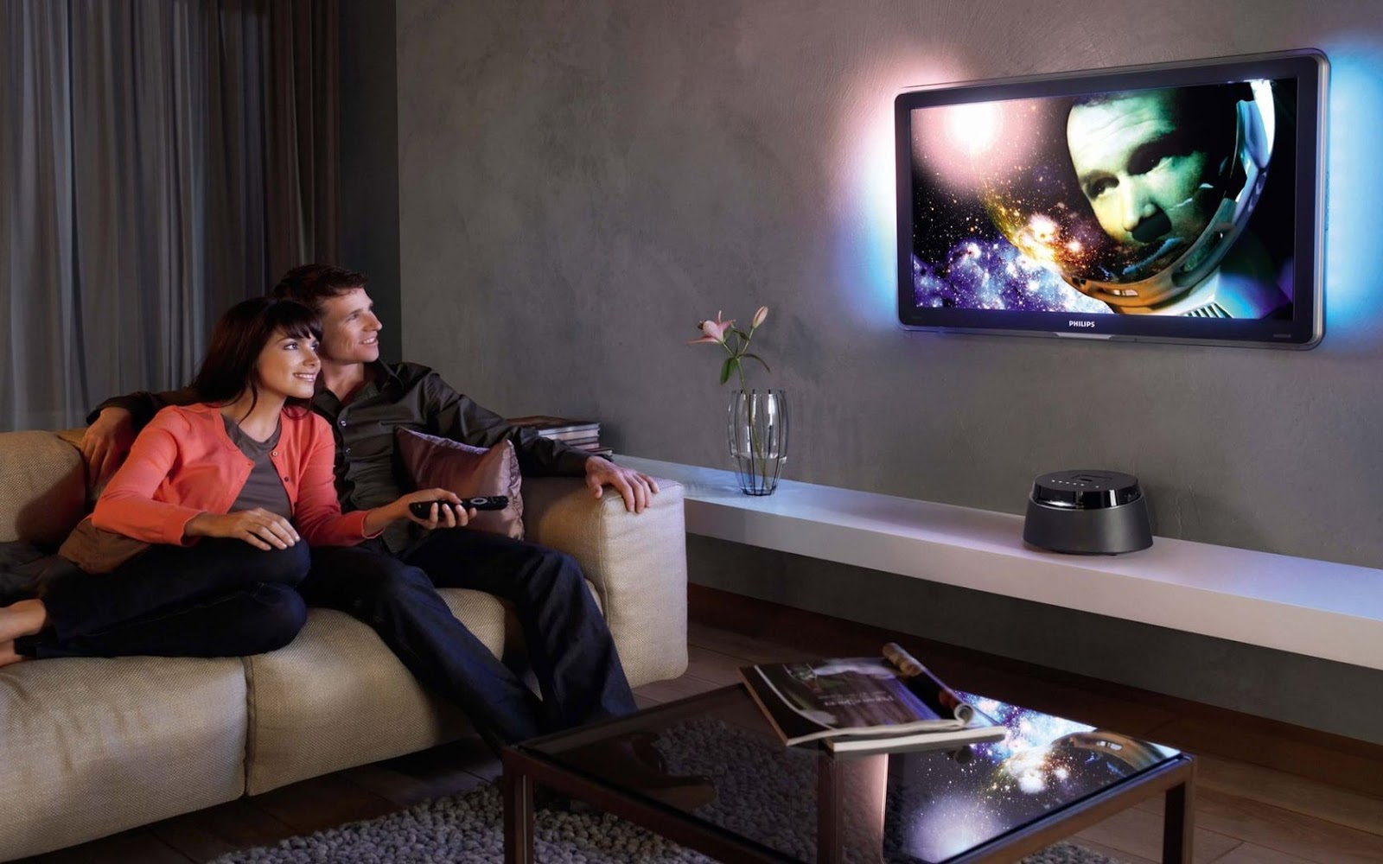
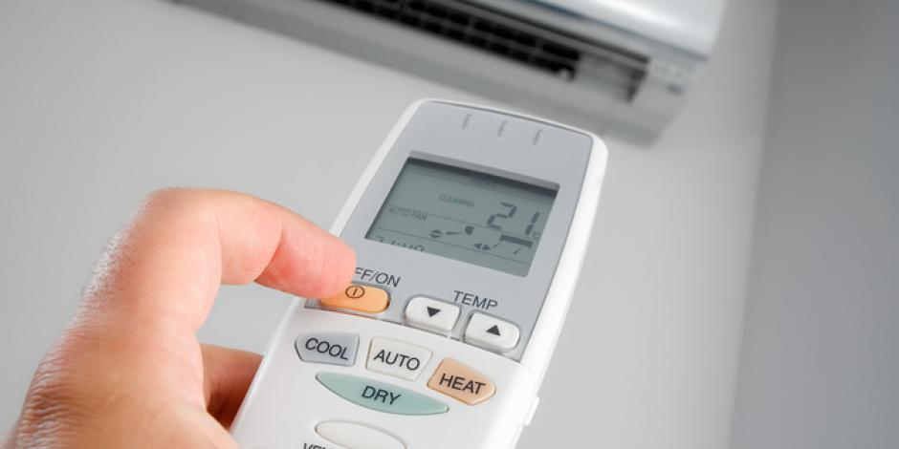
If Home Knows What We Are Doing?
Smarter Energy Consumption
Better User Experience

Slide 3
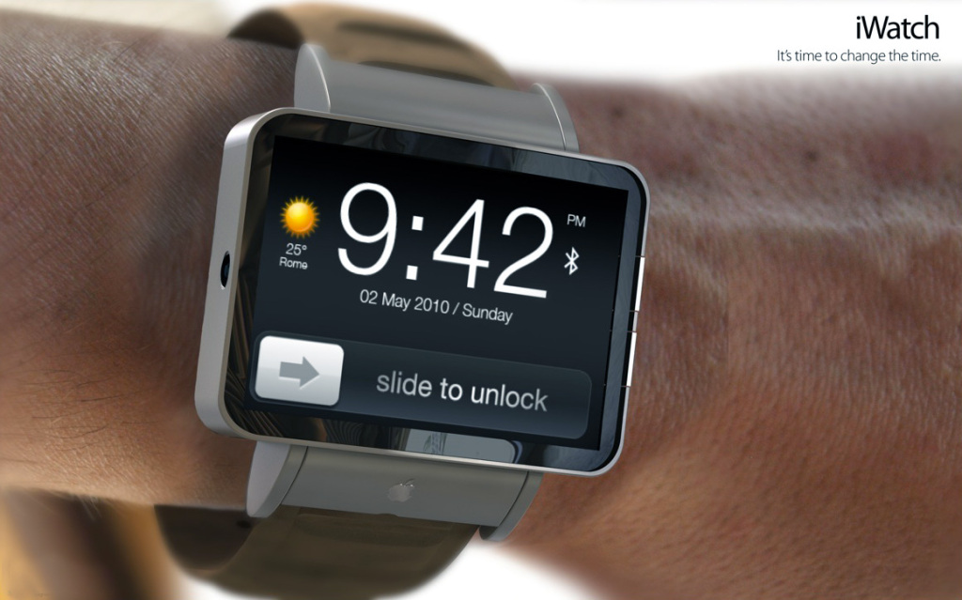
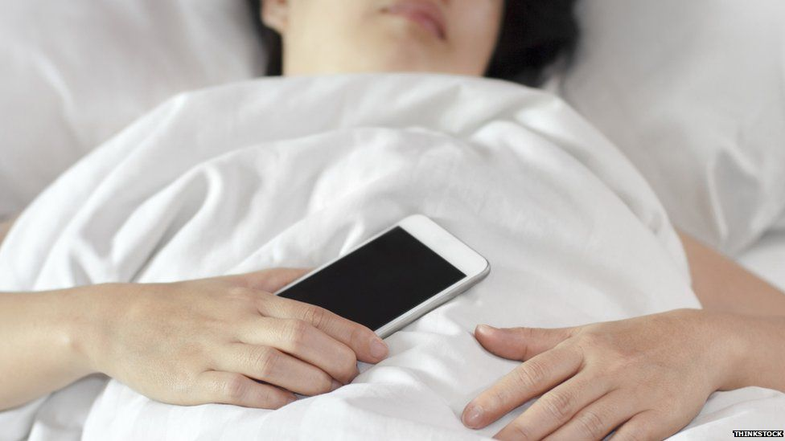
Activity Sensing using Wearable Devices
Continuously wear or carry these devices
Usually charge them (Battery issue)
Notes:
Viet: What do the photos want to say?

Slide 4
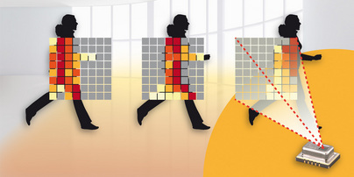
Current Device-free Solutions for Activity Sensing
Interference issues with ISM band devices
Privacy concerns
False alarms
Line-of-sight detection
Privacy and security concerns
High computational overhead
Notes:
Wifi-based sensing
Interference issues with ISM band devices (like microwaves and cordless phones)
Privacy concerns (as RF waves penetrate walls)
Camera-based sensing
Privacy and security concerns
High computational overhead

Slide 5
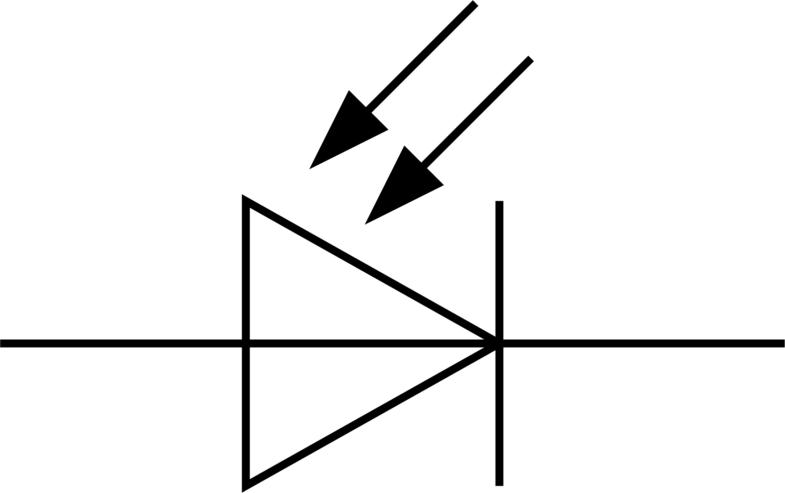
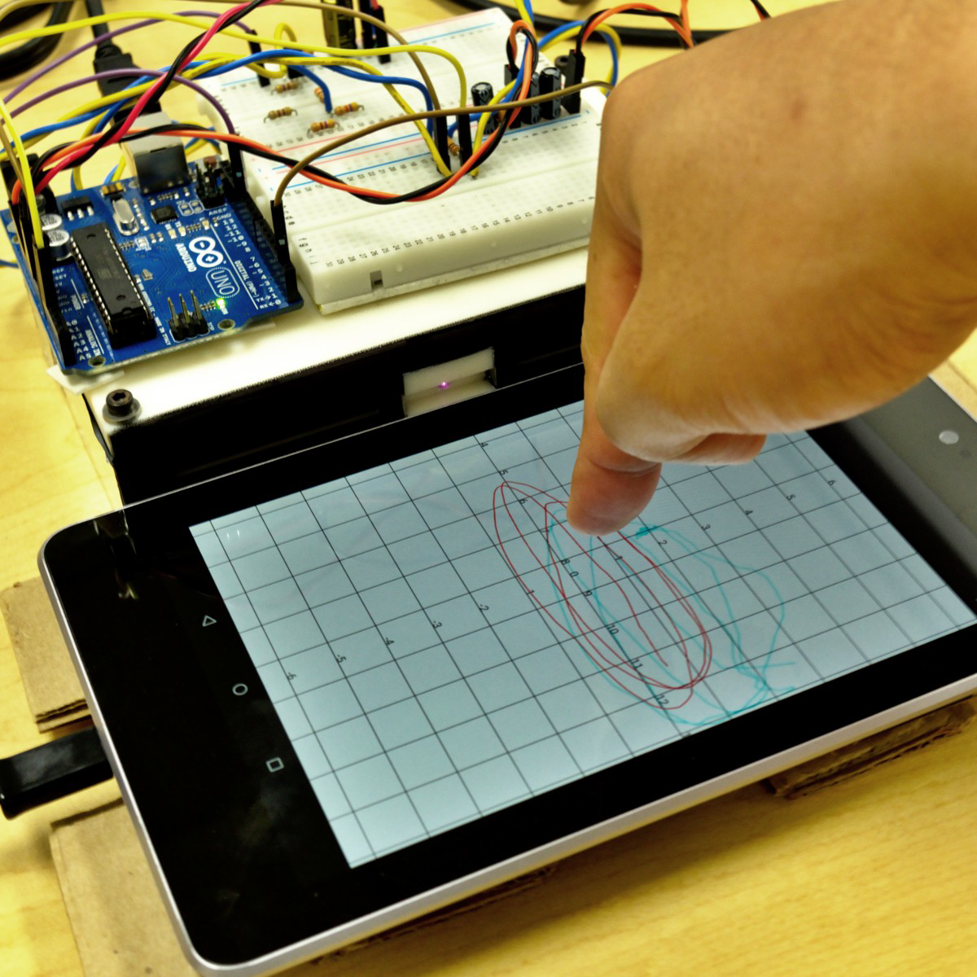
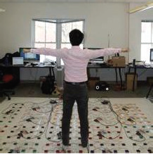
Current Device-free Solutions for Activity Sensing
Leverage lighting infrastructure
Privacy preserving
Easier to identify in which room the activity occurred
Nanometer wavelength
Not affected by temperature changes
Okuli Mobicom’15 LiSense Mobicom’15
Notes:
Locate fingers within the workspace of mobile devices
Demonstrate fine-grained gesture and human skeleton reconstruction
Require deploying photodiodes on the floor (limited scalability)
Demonstrate fine-grained gesture and human skeleton reconstruction
Require deploying photodiodes on the floor (limited scalability)

Slide 6
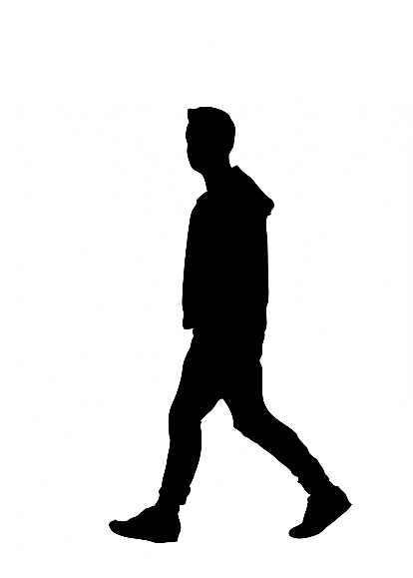
Visible Light based Activity Sensing using Ceiling Photosensors
System Properties:
Monitor shadow cast on the floor
Entirely set up on the ceiling
Same light bulbs you buy
Challenges:
Sensing on the ceilings small light changes reflected from the floor:
Floor materials can absorb or diffuse the light
Light intensity decays with the distance traveled
Each sensor needs to identify which light bulb causes the observed shadow
Node 1
Node 2
Node 3
Node 6
Node 5
Node 4
Processing Server
Notes:
Related work??
Viet: too much text here, probably only put keywords and explain the main ideas verbally.

Slide 7
Visible Light based Activity Sensing using Ceiling Photosensors
System Properties:
Monitor shadow cast on the floor
Entirely set up on the ceiling
Same light bulbs you buy
Challenges:
Sensing on the ceilings small light changes reflected from the floor:
Floor materials can absorb or diffuse the light
Light intensity decays with the distance traveled
Each sensor needs to identify which light bulb causes the observed shadow
Node 1
Node 2
Node 3
Node 6
Node 5
Node 4
Processing Server
Notes:
Related work??
Viet: too much text here, probably only put keywords and explain the main ideas verbally.

Slide 8
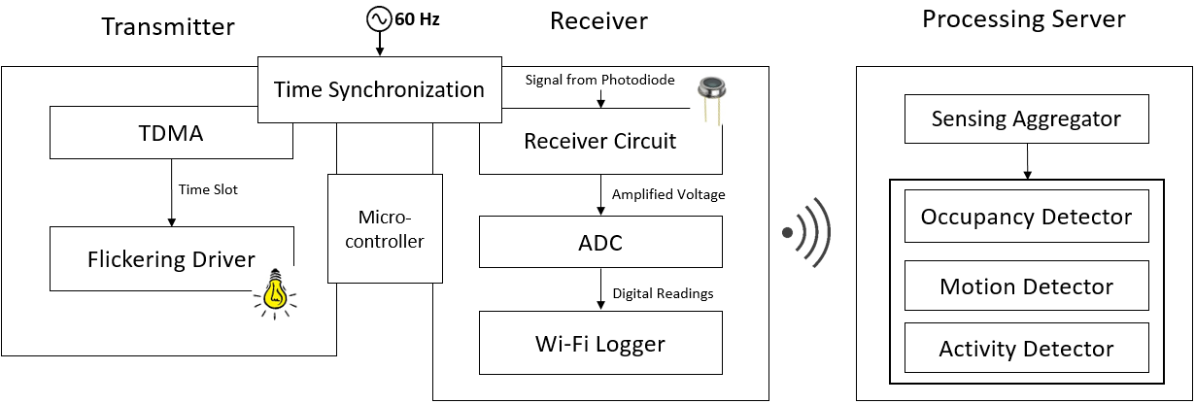
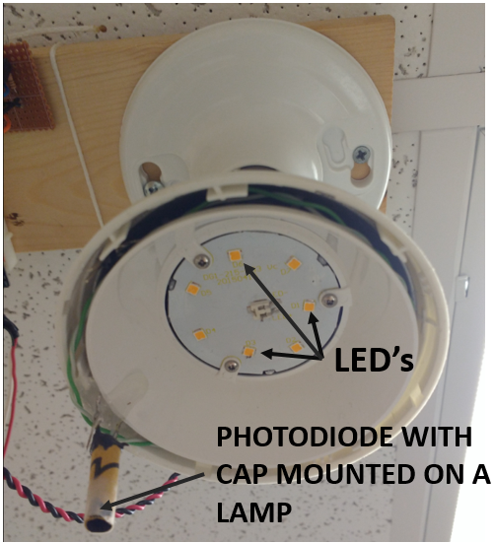
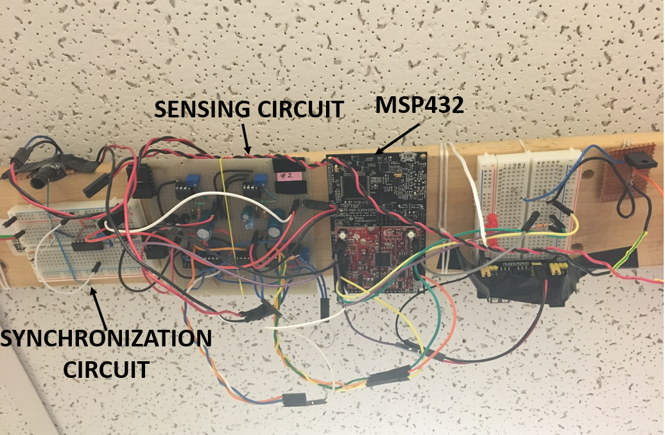
System Overview & Prototype

Slide 9
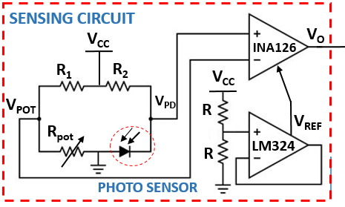
Receiver Circuit
A sensitive difference measurement circuit using Wheatstone bridge:
Notes:
Equation
Viet: Whitestone → Wheatstone

Slide 10
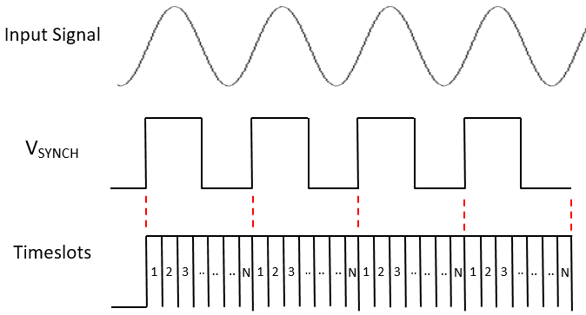
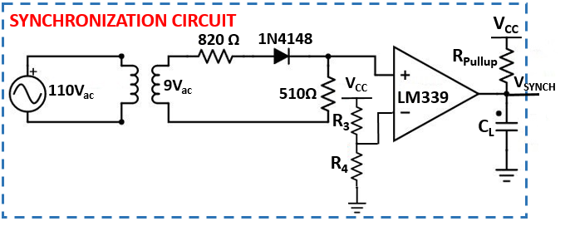
Synchronization Circuit
Each sensor needs to identify which light bulb causes the observed shadow:
A TDMA-like scheme is used based on common synchronization signal
Each light bulb inside the same room blinks in different time slot
Notes:
Viet: be sure that you can briefly describe what the circuit does.

Slide 11
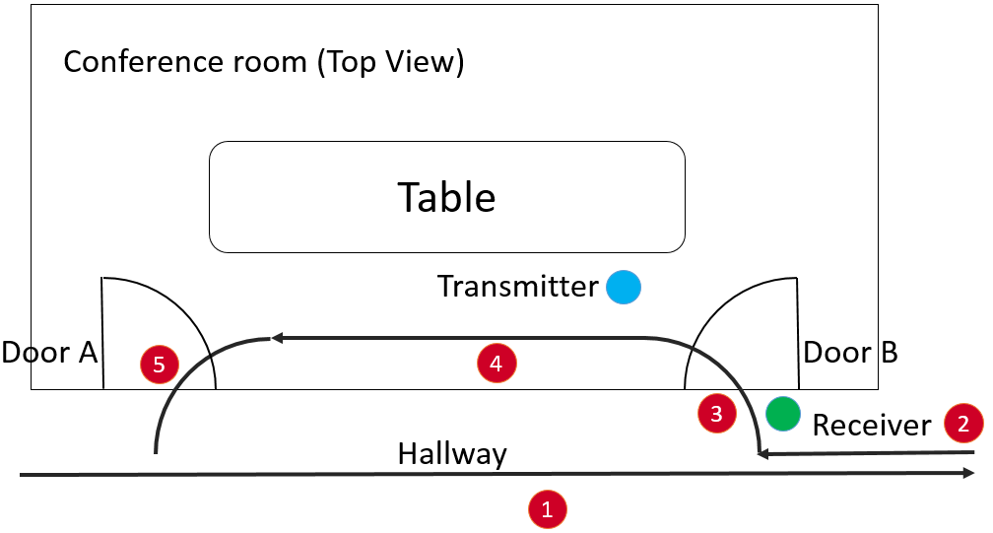
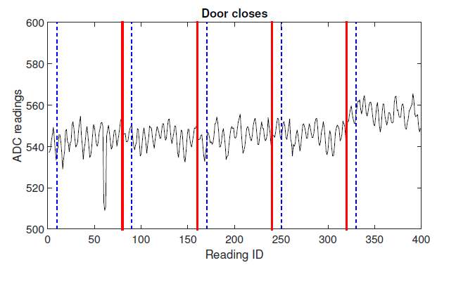
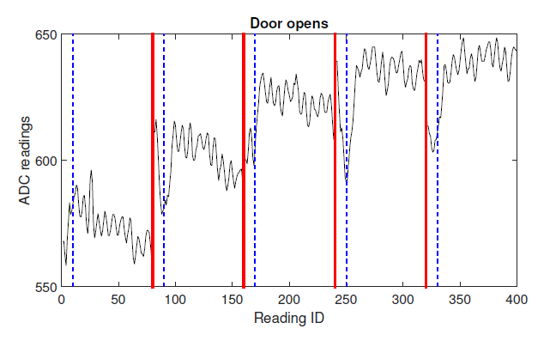
Door opening Detection
Observer dips

Slide 12
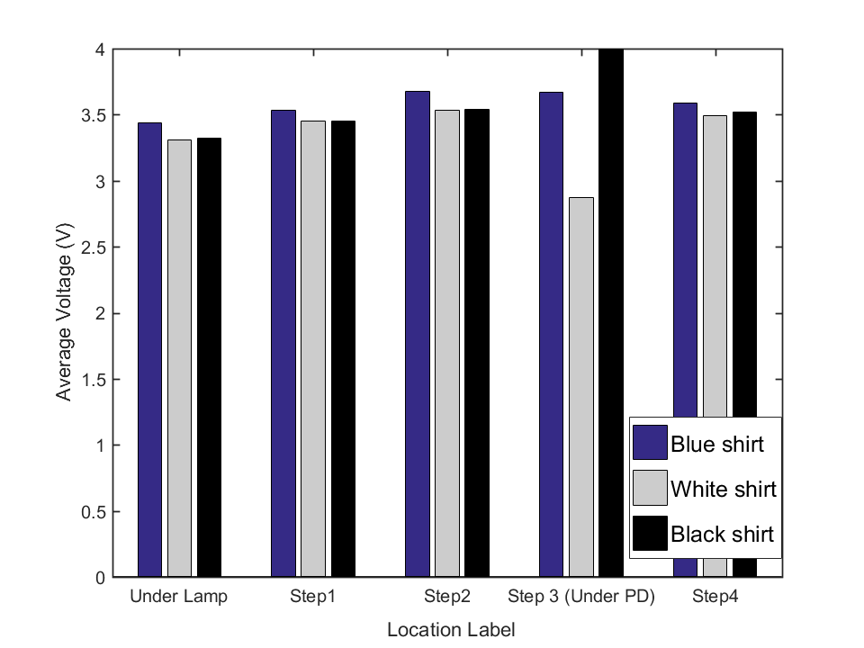
Evaluation- Location Detection
Node 1
Node 2
Notes:
Viet: Fix the photos! They are overlapping

Slide 13
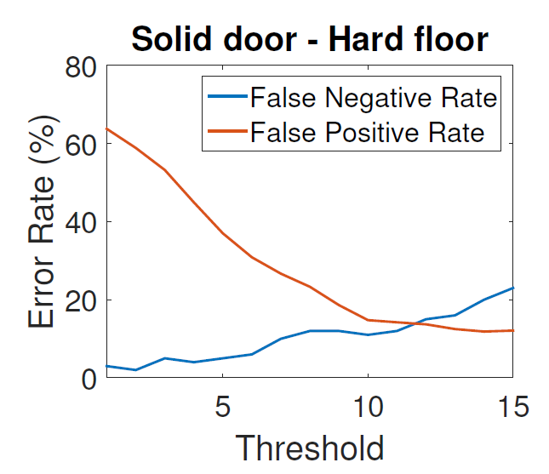
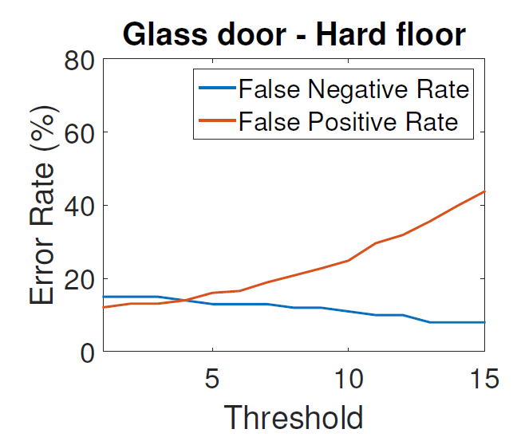
Evaluation- Detecting door opening
10 participants
Each person walk the defined path 10 times
Two types of doors
Notes:
13% when the threshold is 12. In the case of glass door and hard floor, we achieve the equal
error rate of 12% when the threshold is 4.
Viet: Do you describe the algorithm to detect the door opening somewhere or just describe it verbally? It might be better if having some algorithm workflow.

Slide 14
Conclusion and Future Work
Showed promising results using our prototype for location and doors opening detection
Lessons to learn
High sensitive sensing circuit is required for sensing from ceilings
More concurrent nodes requires accurate synchronization scheme
Increasing sensitivity resolution by adding more sensors per node
Notes:
Viet: List two or three main points of this work?

Slide 15
Thank you!

