Slide 1



Diversity Combining and Piezoelectric Beam Steering for
Multi-Element VLC Networks
Presenter: Yusuf Said Eroglu
Authors: Yusuf Said Eroglu, Ismail Guvenc, Alphan Sahin, Murat Yuksel, and Nezih Pala

Slide 2
Outline
Background
Multi-Element VLC Transmitters and Receivers
  System Model
    Transmitter And Receiver Architectures
    Combining Techniques
  Simulation Results
  Piezoelectric Beam Steering
  Conclusion
  Future Studies
  Q&A

Slide 3
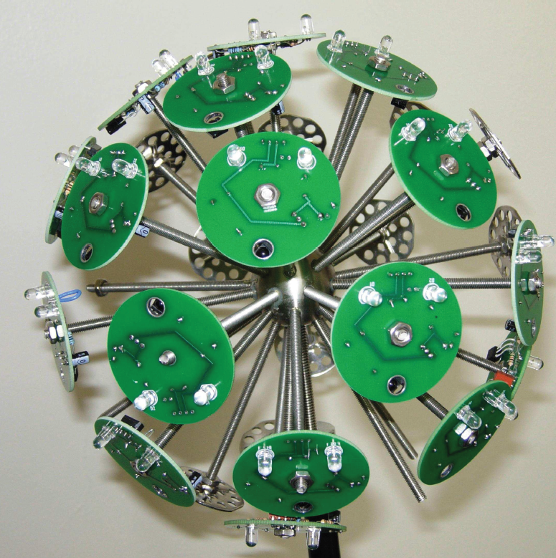
Background
Multi-LED transmitters
  Angle diversity
  Serves many users
  Easy to install and maintain
  High accuracy localization
Multi-PD receivers
  Provides better SINR by utilizing many PDs
  Space diversity
Notes:
Multi-PD nin calisilmis olmasi

Slide 4
Objectives
SINR performance of the multi-LED transmitters
Achievable SINRs when it is used with multi-PD receiver
Optimal parameters for the multi-PD receiver
Evaluate with computer simulations

Slide 5
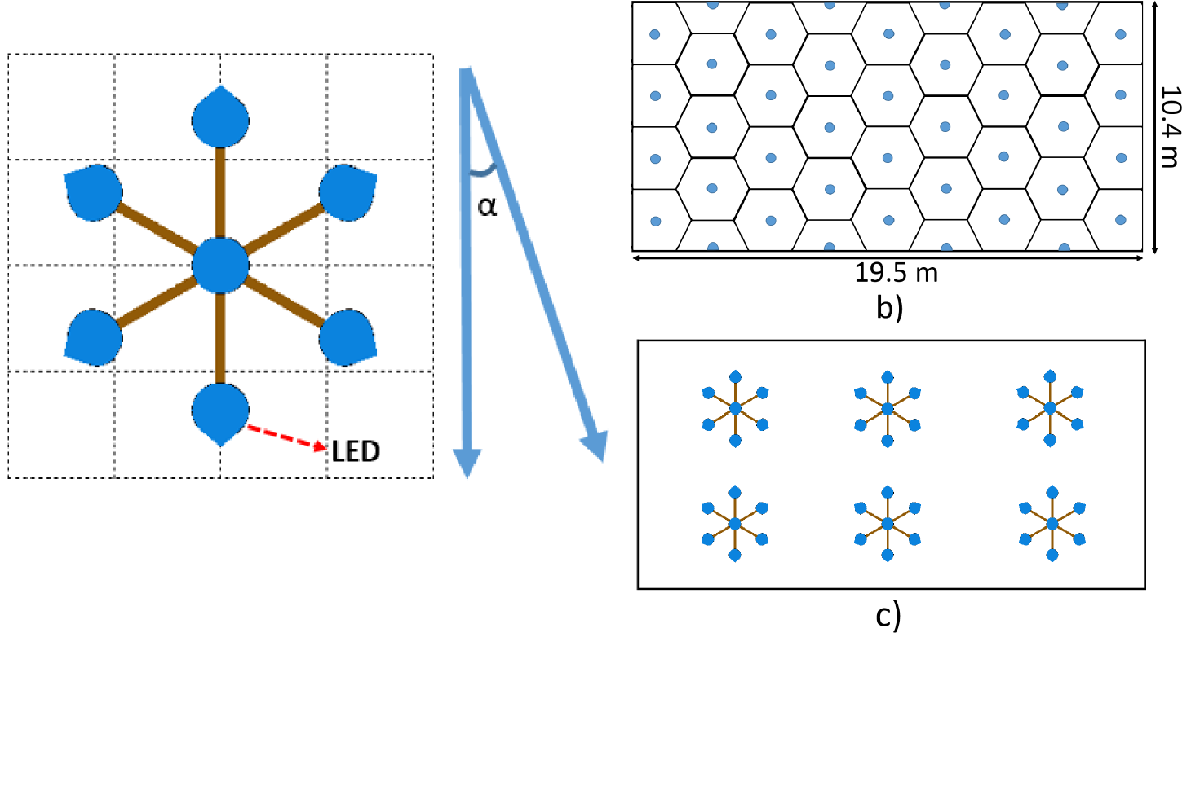
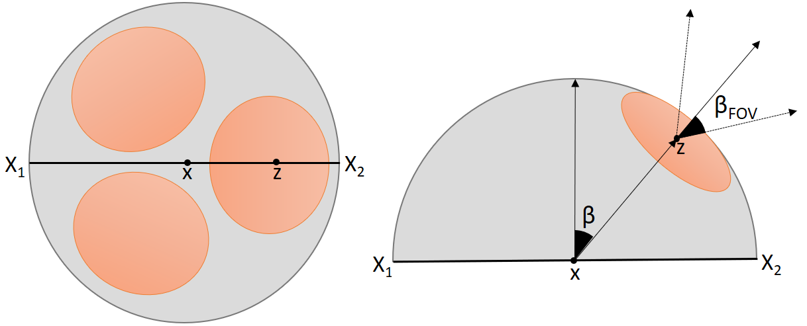
System Model – Tx and Rx Architectures
Transmitters:
  Single-LED and 7-LED
Tilt angle of LEDs: α
LED directivity index i
Receivers:
  Single-PD
  3-PD
  7-PD
Field of view: β_{FOV}
Tilt angle of PDs: β
a) The top view of 7-LED transmitter, and α angle between center and side LEDs.
a) The top view of 7-LED transmitter, and α angle between center and side LEDs.
3-PD receiver with β_{FOV} and β angles
Notes:
We assume each user is served by one LED only.
The directivity index is 7.4, which corresponds to 25 degree half-intensity radiation angle.
α = 45 degree

Slide 6

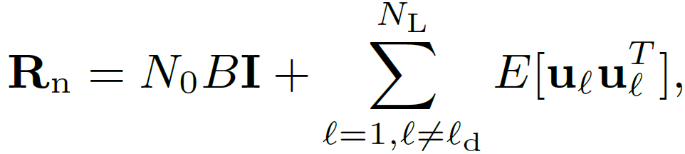

System Model – Combining Schemes
Four receiver combining schemes: Selective Best (SBC), Equal Gain (EGC), Maximum Ratio (MRC) and Optimal Combining (OPC).
For Maximum Ratio Combining (MRC)
Single-PD
For Multi-PD receivers
For Optimal Combining (OPC)
For Selective Best Combining (SBC), w_{p} is either 1 or 0.
For Equal Gain Combining (EGC), w_{p} = 1 for all PDs.

Slide 7
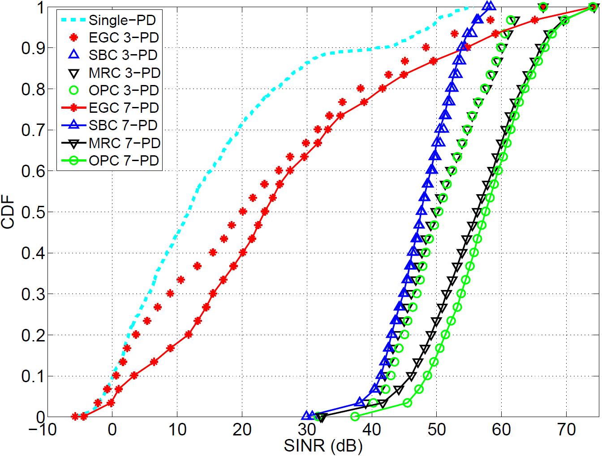
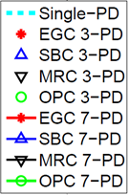
Simulation Results – SINR CDFs
3-PD and 7-PD SBC
3-PD MRC and OPC
Single-PD
3-PD EGC
7-PD MRC
7-PD EGC
7-PD OPC
For single-LED transmitter configuration

Slide 8
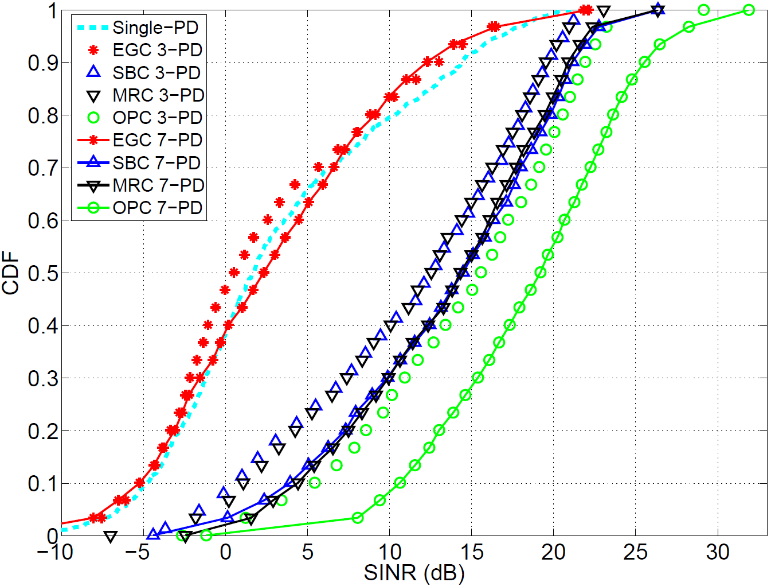
Simulation Results – SINR CDFs
3-PD SBC and MRC
7-PD SBC and MRC
3-PD OPC
Single-PD and EGC
7-PD OPC
For 7-LED transmitter configuration

Slide 9
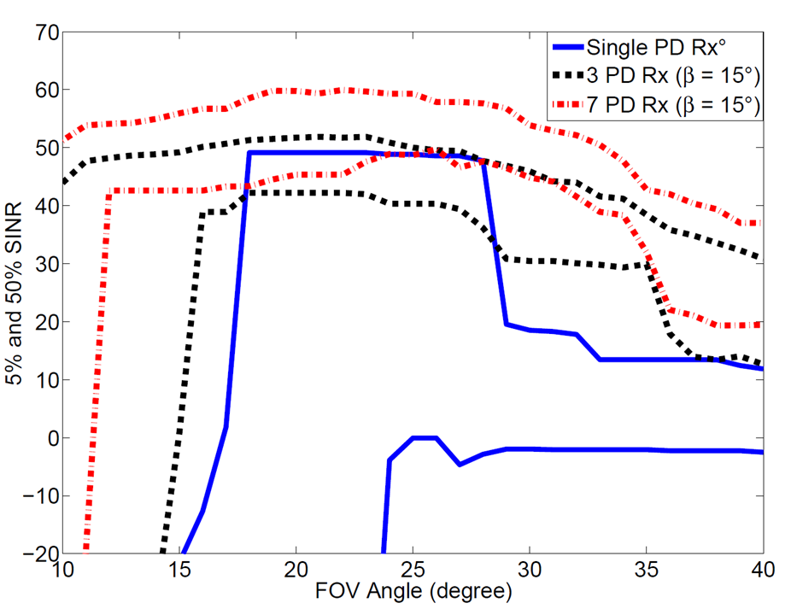

Simulation Results – Optimal Parameters
%50 SINR 3 PD
%50 SINR 7 PD
%5 SINR 3 PD
%5 SINR 7 PD
%50 SINR Single PD
%5 SINR Single PD
5% and 50% SINR for single-LED transmitter vs different β_{FOV} values

Slide 10
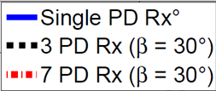
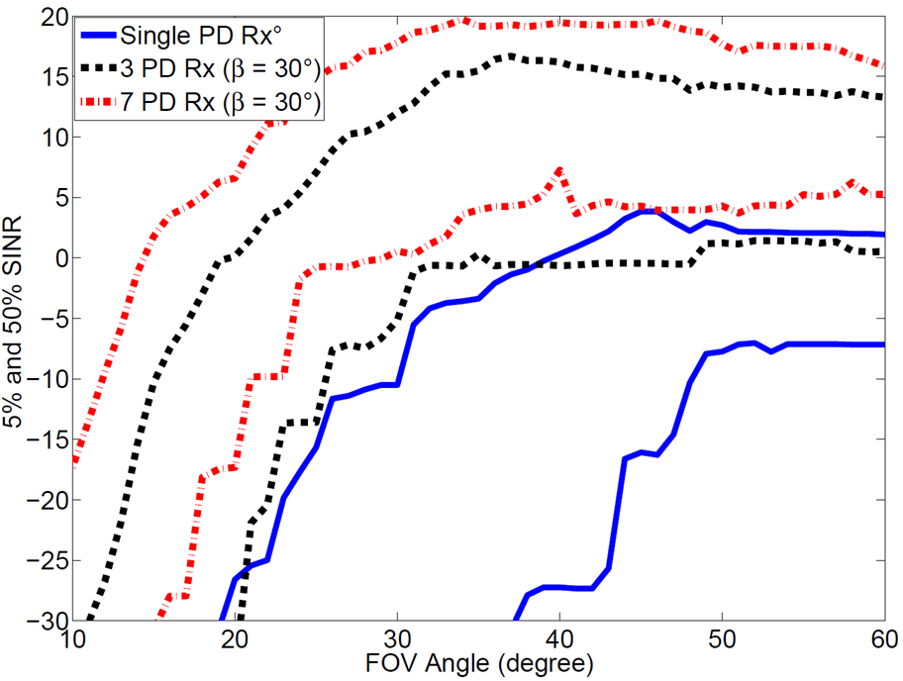
Simulation Results – Optimal Parameters
%50 SINR 7 PD
%5 SINR 7 PD
%50 SINR 3 PD
%5 SINR 3 PD
%50 SINR Single PD
%5 SINR Single PD
5% and 50% SINR for 7-LED transmitter vs different β_{FOV} values

Slide 11
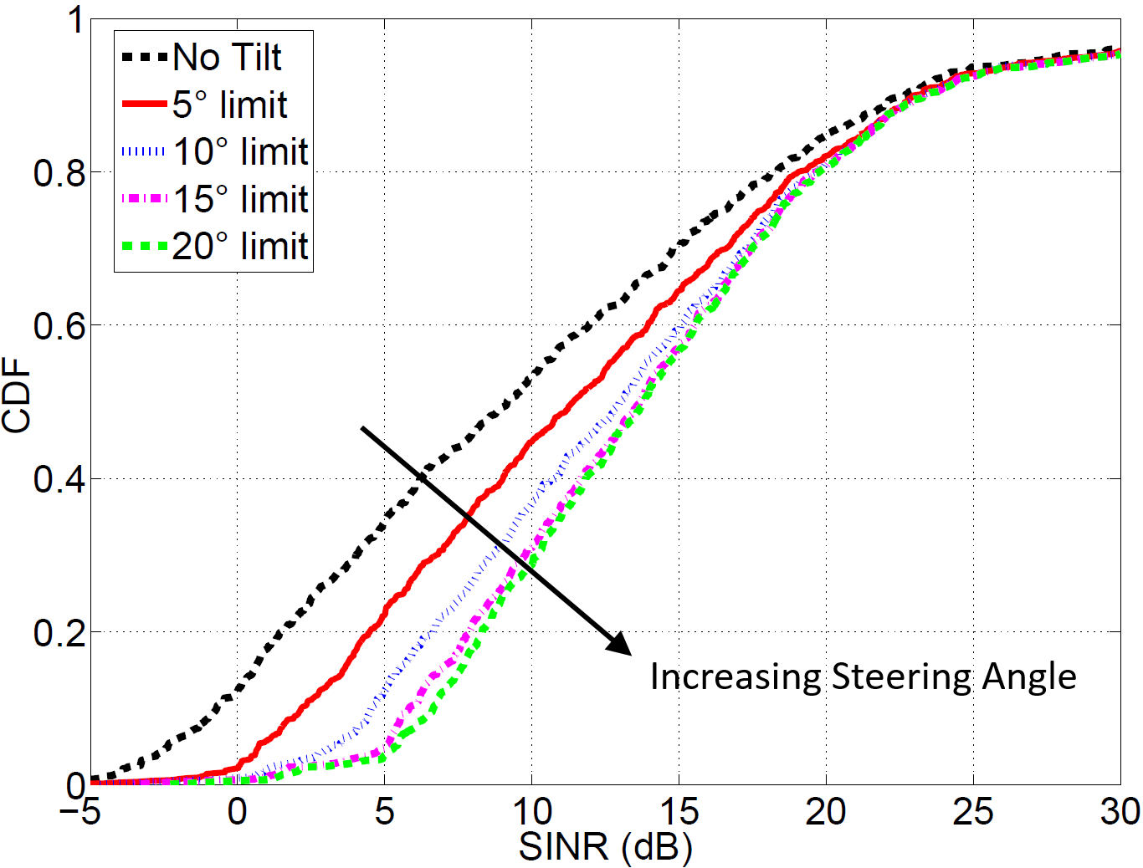
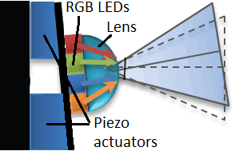
Piezoelectric Beam Steering
LEDs will be steered to track the location of the receiver
Assuming known location
Notes:
Precision ceramic actuators which convert electrical energy to linear motion
Beam steering is commonly used in free space optic (FSO) systems
Assuming known location
Cost increases with more motion capability

Slide 12
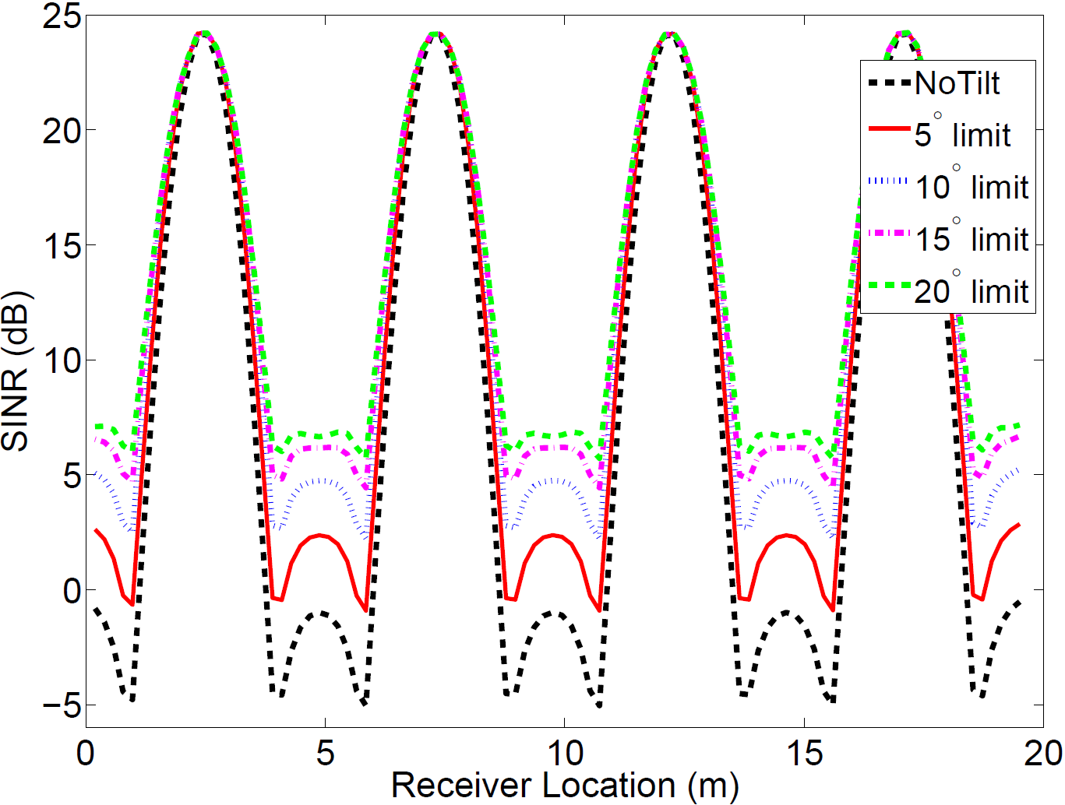
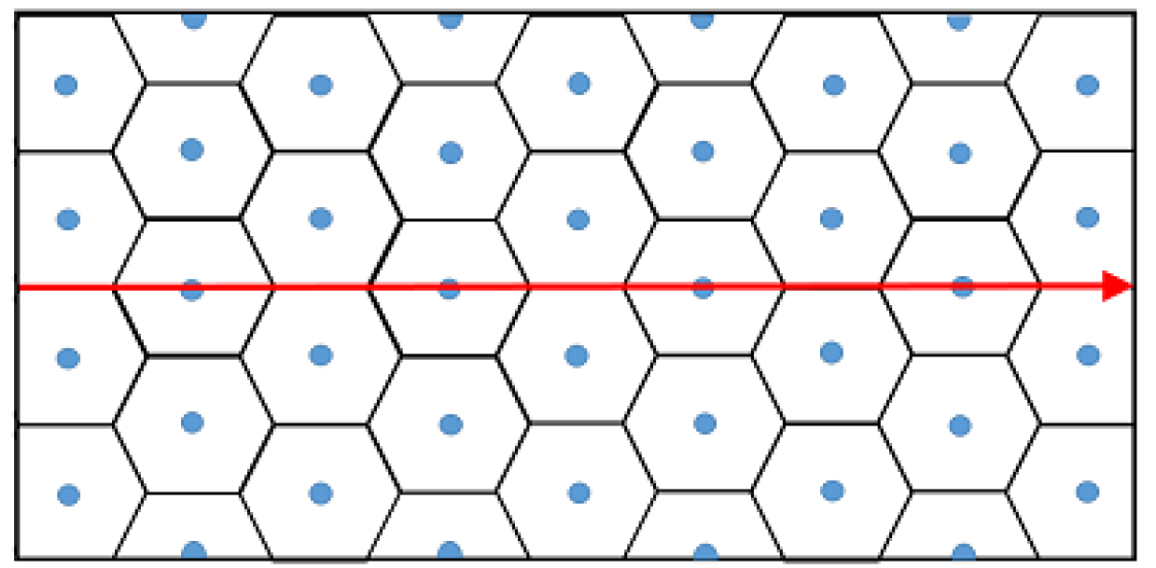
Piezoelectric Beam Steering
SINR is especially improved at cell edge, which will provide better link during handover.

Slide 13
Conclusion
SINR performances of different multi-PD combining schemes are investigated for different transmitter structures
    OPC is particularly found to be more efficient for multi-LED transmitters
Optimal parameters for multi-PD receivers are studied
  Optimal FOV and tilt angle increases when multi-LED transmitters are used
Piezoelectric beam steering is proposed to improve SINR further
  Up to 7 dB SINR gain at low SINR region with 10° tilt

Slide 14
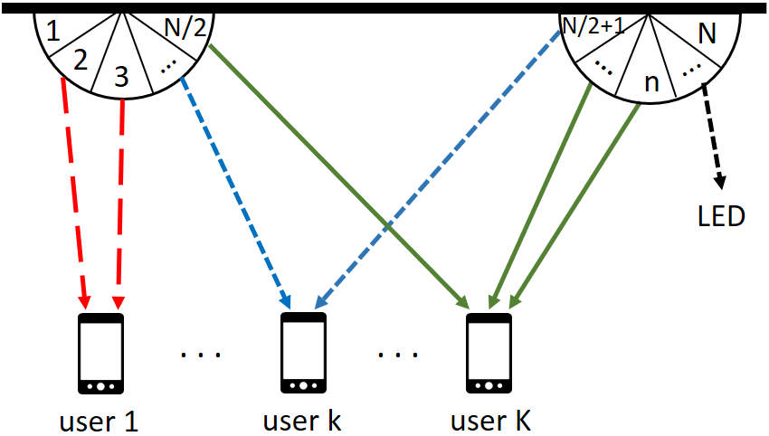
Future Studies
Maximum sum rate
Fairness
QoS guarantees
Optimal assignment of LEDs to users

Slide 15
Q&A
Thank you for listening!

